Slide 1
Electrical Circuits
EEE-281 Lecture Notes
Dr. Özçel Cangül
Lecture Notes by Dr. Ali Muhtaroğlu
Fall 2023
METU Northern Cyprus Campus
References:
Electric Circuits 10th Ed. by Nilsson & Riedel
Electrical Circuit Analysis 3rd Ed. by Johnson, Johnson, Hilburn, and Scott
Engineering Circuit Analysis 7th Ed. by Hayt, Kemmerly, and Durbin
Fundamentals of Electric Circuits 3rd Ed. by Alexander, and Sadiku

Slide 2
Energy Storage Elements
Weeks 11-12
Reading: Nilsson & Riedel Chapter 6
Ali Muhtaroğlu

Slide 3
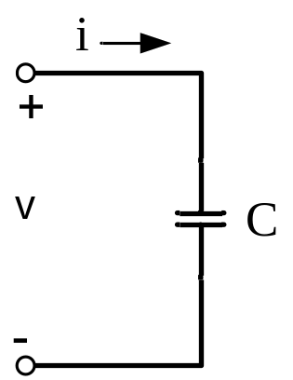
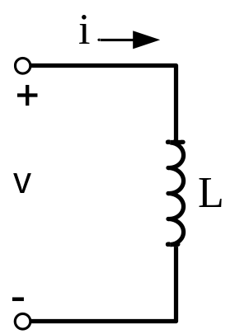
Introduction
So far only considered circuits with resistors and sources (and op-amps)
– Terminal characteristics are simple algebraic equations
Next, will study dynamic elements which can store energy to be retrieved at a later time. Hence they are called energy storage elements.
– Terminal equations involve derivatives and integrals
– Will want to freshen up some of your calculus
Capacitor:
Inductor:

Slide 4
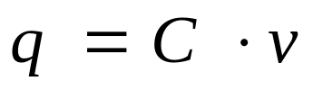
Capacitor
A capacitor physically consists of two conducting surfaces separated by a thin insulating layer (or dielectric) with a very large resistance. Charge can be stored on the conducting “plates”.
The potential difference across the capacitor is the net work done in transporting a 1 Coulomb charge between the terminals. The proportionality constant between the charge and the potential difference for a linear capacitor is capacitance, C.
Units of C: C/V or Farad (F)

Slide 5
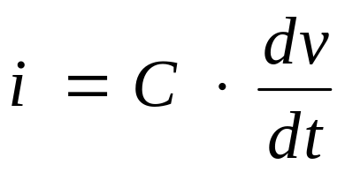
Capacitor
A capacitor physically consists of two conducting surfaces separated by a thin insulating layer (or dielectric) with a very large resistance. Charge can be stored on the conducting “plates”.
The potential difference across the capacitor is the net work done in transporting a 1 Coulomb charge between the terminals. The proportionality constant between the charge and the potential difference for a linear capacitor is capacitance, C.
Units of C: C/V or Farad (F)
Differentiate the above equation w.r.t. t to
get the terminal law for a capacitor:

Slide 6
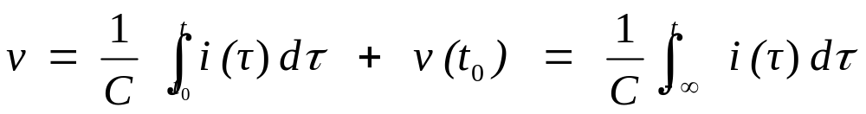
Capacitor
Terminal law for a capacitor:
Note as the symbol implies, a capacitor behaves like an open circuit when voltage is constant (DC).
The only time there is current through a capacitor is when the voltage is changing (dv/dt ≠ 0).
Continuity Principle: The voltage across a capacitor is always continuous. Total charge cannot change instantaneously [would require infinite current to change voltage instantaneously.]
Voltage in terms of current can be formulated by integrating both sides in the above equation:

Slide 7
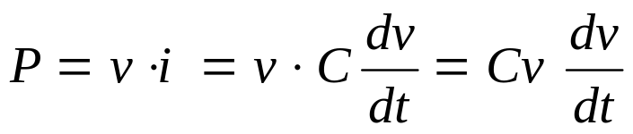
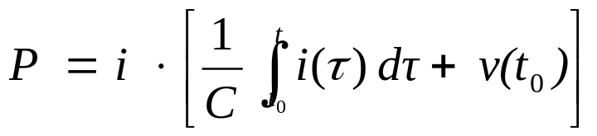
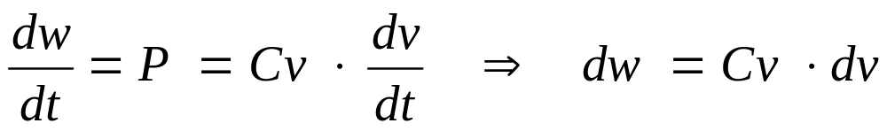
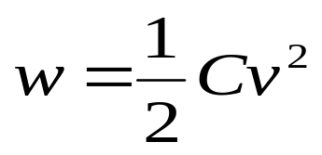
Capacitor Power and Energy
Using the definition of power, if v is known:
Alternatively if i is known,
Using the relationship of energy (work) with power:
Integrating both sides to get energy:
[The integration assumes a reference of
zero energy at zero voltage.]

Slide 8
Example (Johnson & Johnson)
A 0.2 μF capacitor has a charge of 20 μC.
Find its voltage and energy.

Slide 9
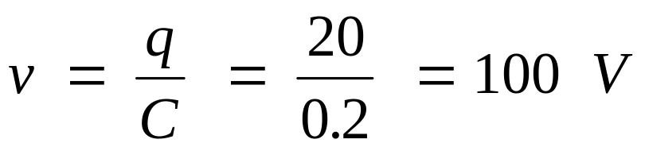
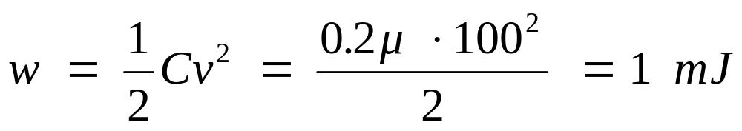
Example (Johnson & Johnson)
A 0.2 μF capacitor has a charge of 20 μC.
Find its voltage and energy.

Slide 10
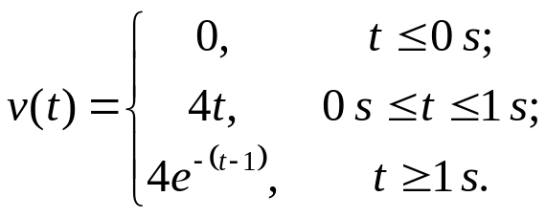
Example (Nilsson & Riedel)
The voltage pulse described by the following equations is impressed across the terminals of a 0.5 μF capacitor:
i) Derive the capacitor current, power and energy. Sketch all as a function of time.

Slide 11
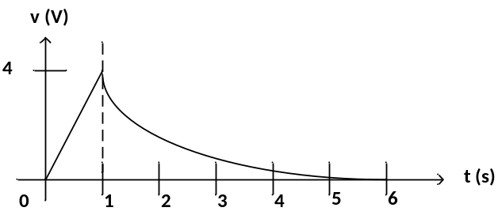
Example (Nilsson & Riedel)
The voltage pulse described by the following equations is impressed across the terminals of a 0.5 μF capacitor:
First voltage:
i) Derive the capacitor current, power and energy. Sketch all as a function of time.

Slide 12
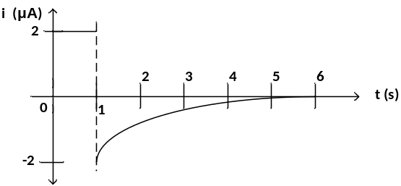
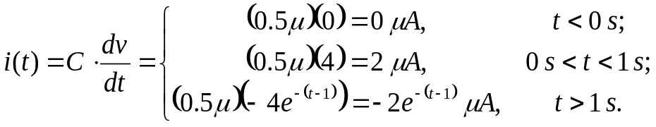
Example (Nilsson & Riedel)
The voltage pulse described by the following equations is impressed across the terminals of a 0.5 μF capacitor:
i) Derive the capacitor current, power and energy. Sketch all as a function of time.
(chain rule of differentiation)

Slide 13
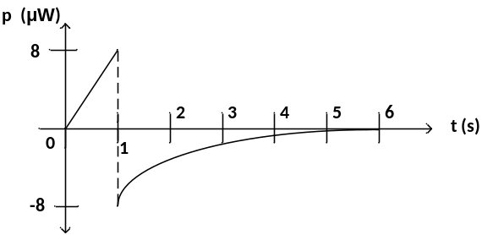
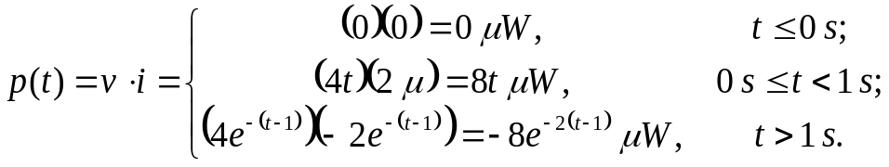
Example (Nilsson & Riedel)
The voltage pulse described by the following equations is impressed across the terminals of a 0.5 μF capacitor:
i) Derive the capacitor current, power and energy. Sketch all as a function of time.

Slide 14
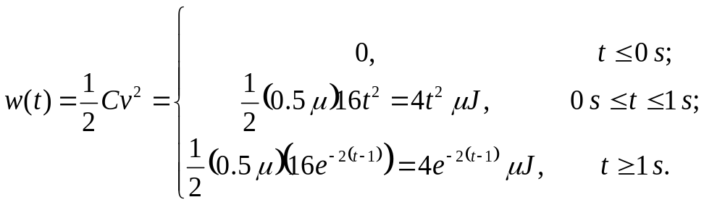
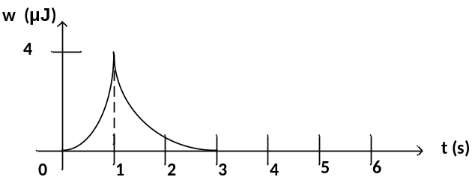
Example (Nilsson & Riedel)
The voltage pulse described by the following equations is impressed across the terminals of a 0.5 μF capacitor:
i) Derive the capacitor current, power and energy. Sketch all as a function of time.

Slide 15
Example (Nilsson & Riedel)
The voltage pulse described by the following equations is impressed across the terminals of a 0.5 μF capacitor:
ii) Interval of time when energy is being stored in the capacitor ?

Slide 16
Example (Nilsson & Riedel)
The voltage pulse described by the following equations is impressed across the terminals of a 0.5 μF capacitor:
ii) Interval of time when energy is being stored in the capacitor ?
Energy is being stored when the power is positive (based on original assumptions):
0s < t < 1s

Slide 17
Example (Nilsson & Riedel)
The voltage pulse described by the following equations is impressed across the terminals of a 0.5 μF capacitor:
iii) Interval of time when energy is being delivered by the capacitor ?

Slide 18
Example (Nilsson & Riedel)
The voltage pulse described by the following equations is impressed across the terminals of a 0.5 μF capacitor:
iii) Interval of time when energy is being delivered by the capacitor ?
Energy is being delivered when the power is negative (based on original assumptions):
t > 1s

Slide 19
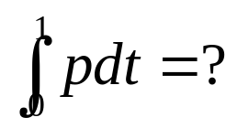
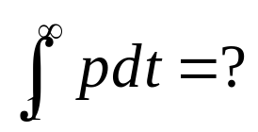
Example (Nilsson & Riedel)
The voltage pulse described by the following equations is impressed across the terminals of a 0.5 μF capacitor:
iv) Evaluate the following integrals and comment on their significance:

Slide 20
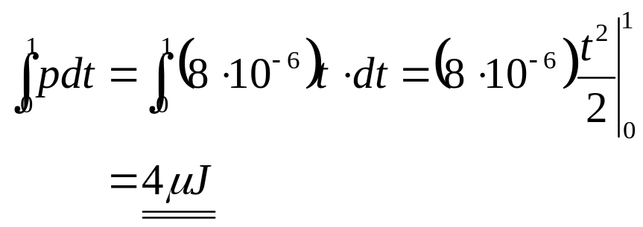
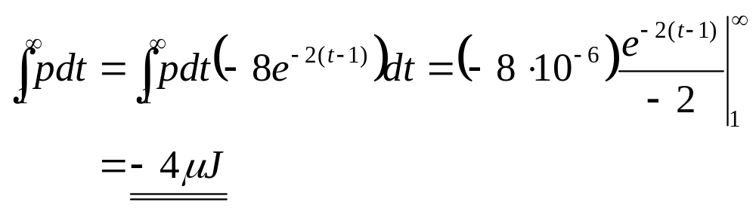
Example (Nilsson & Riedel)
The voltage pulse described by the following equations is impressed across the terminals of a 0.5 μF capacitor:
iv) Evaluate the following integrals and comment on their significance:
This is the energy stored in the capacitor during 0s < t < 1s.
This is the energy delivered by the capacitor during t > 1s.

Slide 21
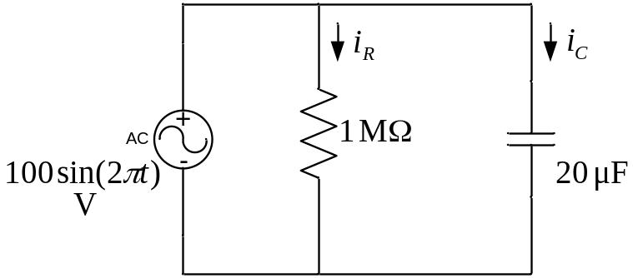
Example
i) Find the current through the resistor and the capacitor
ii) Find the energy stored in the capacitor as a function of time
iii) Find the energy dissipated in the resistor as a function of time

Slide 22
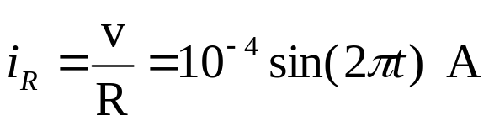
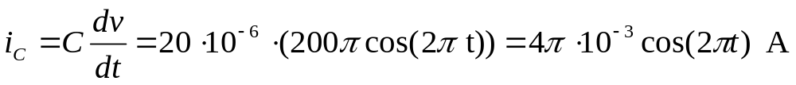
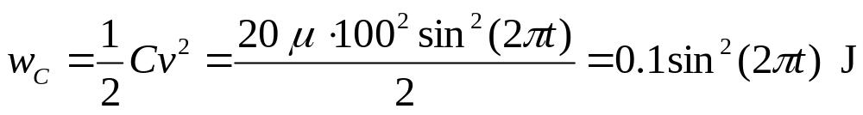
Example
i) Find the current through the resistor and the capacitor
(chain rule of differentiation)
ii) Find the energy stored in the capacitor as a function of time
iii) Find the energy dissipated in the resistor as a function of time
(double angle formula)

Slide 23
Example
Notes:
• The energy stored at the capacitor increases to maximum at t=0.25s and then
decreases back to zero at t=0.5s (energy is never consumed for the ideal
capacitor.)
• During the same 0.5s interval, the resistor consumes 2.5 mJ of energy.
ii) Find the energy stored in the capacitor as a function of time
iii) Find the energy dissipated in the resistor as a function of time
Ali Muhtaroglu

Slide 24
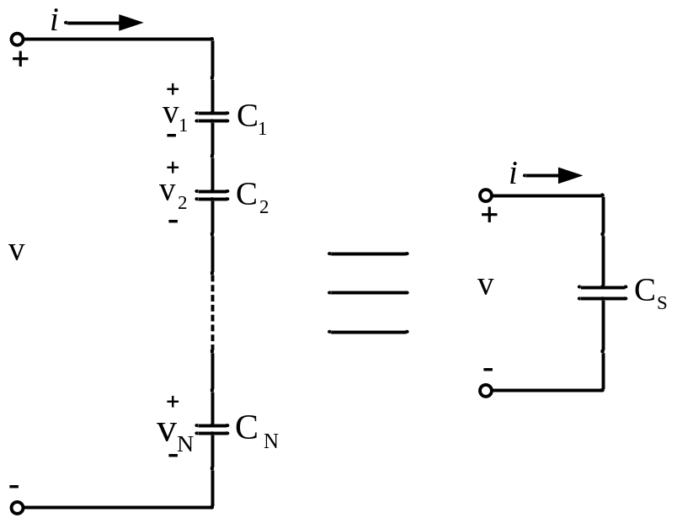
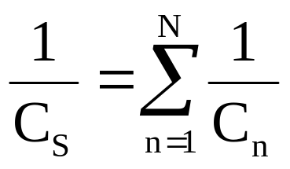
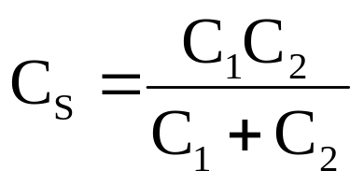
Series and Parallel Capacitors
The equivalent of a chain of series-connected
capacitors is a single capacitor whose inverse
capacitance is the sum of inverses of the
series capacitances:
In the case of 2 series
capacitances:

Slide 25
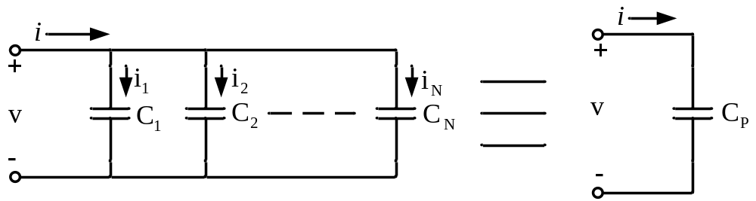
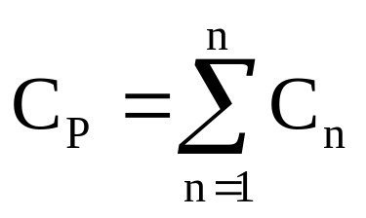
Series and Parallel Capacitors
The equivalent of a chain of series-connected
capacitors is a single capacitor whose inverse
capacitance is the sum of inverses of the
series capacitances:
In the case of 2 series
capacitances:
The equivalent of a parallel capacitors is a single
capacitor whose capacitance is the sum of capacitances of the parallel capacitors:

Slide 26
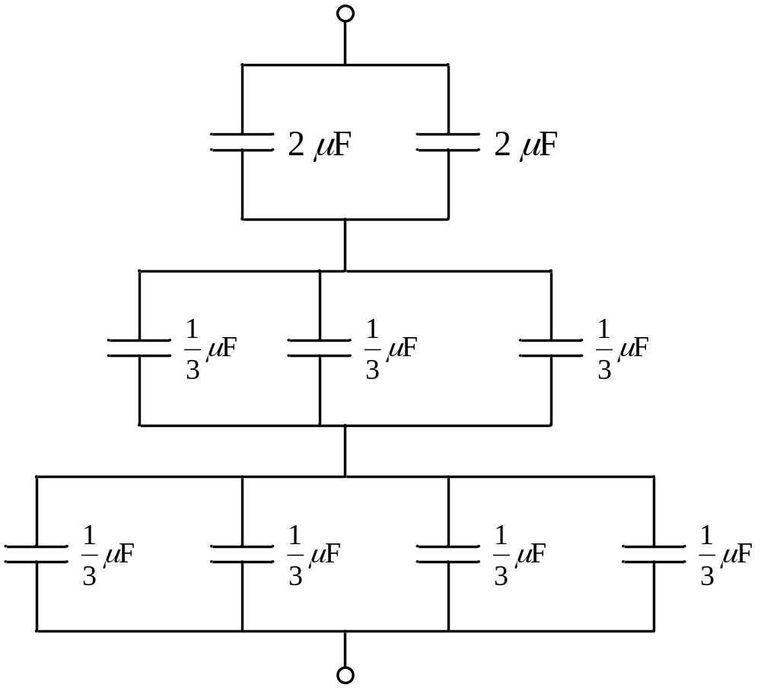
Example
Find the equivalent capacitance for the following circuit:

Slide 27
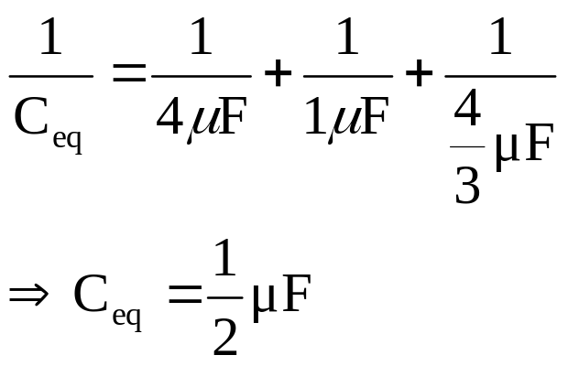
Example
Find the equivalent capacitance for the following circuit:

Slide 28
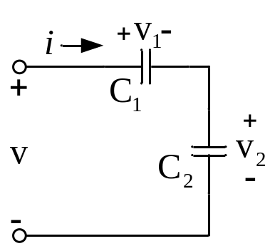
Example : Capacitor Voltage/Current Division
Derive the equation for voltage division, assuming the
capacitors are initially uncharged:

Slide 29
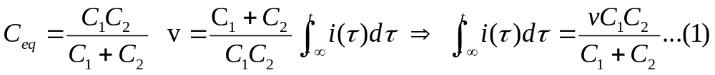
Example : Capacitor Voltage/Current Division
Derive the equation for voltage division, assuming the
capacitors are initially uncharged:

Slide 30
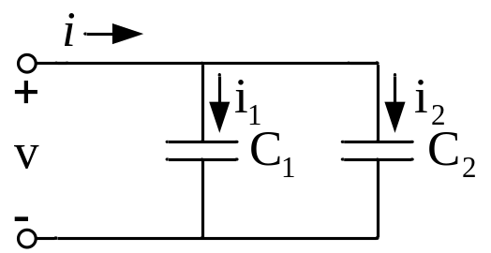
Example : Capacitor Voltage/Current Division
Derive the equation for voltage division, assuming the
capacitors are initially uncharged:
Derive the equation for current division:

Slide 31
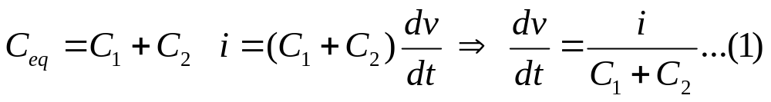
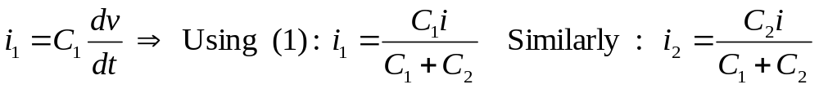
Example : Capacitor Voltage/Current Division
Derive the equation for voltage division, assuming the
capacitors are initially uncharged:
Derive the equation for current division:

Slide 32
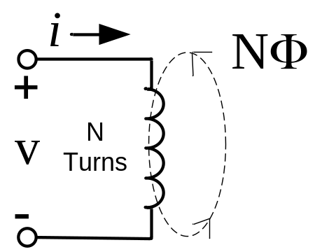

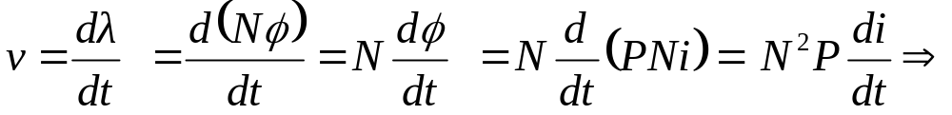
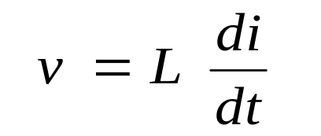

Inductor
An inductor is a two-terminal device that consists of a coiled conducting wire wound
around a core.
Current flowing through an inductor produces magnetic flux φ. If the coil that makes
up the inductor contains N turns, the total flux linked by the N turns of the coil is:
The magnitudes of the flux and the coil current are related by:
Where N is the number of turns on the coil and P is the permeance of space occupied by the flux (magnetic property of this space.)
The law of electromagnetic induction: The induced voltage is equal to the time rate
of change of the total magnetic flux:
Also for a linear inductor.
The terminal law for a inductor
Units of L: Wb/A or Henry (H)

Slide 33
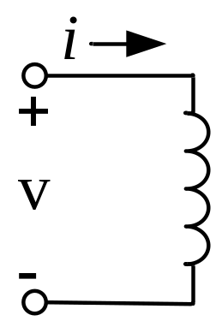
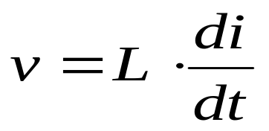
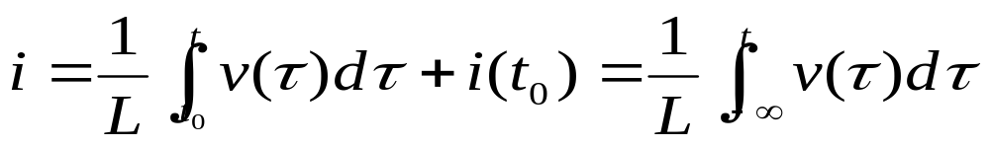
Inductor
Terminal law for an inductor:
Note as the symbol implies, an inductor behaves like a short circuit when current is constant (DC) (i.e. it is nothing but a wire).
The only time there is voltage across an inductor is when the current is changing (di/dt ≠ 0).
Continuity Principle: The current through an inductor is always continuous [would require infinite voltage to change current instantaneously.]
Current in terms of voltage can be formulated by integrating both sides in the above equation:

Slide 34
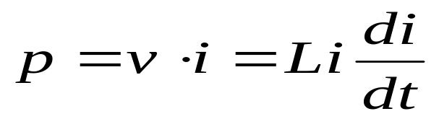
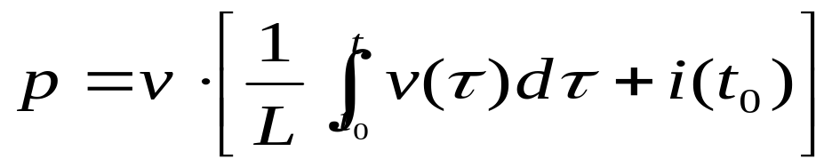
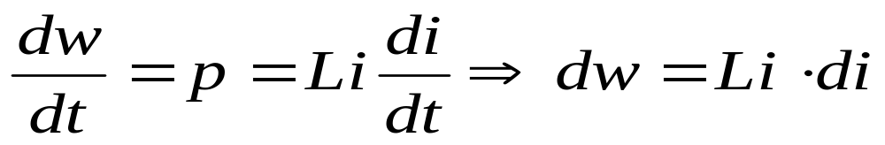
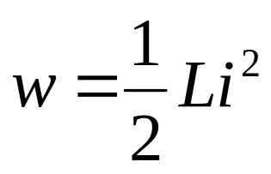
Inductor Power and Energy
Using the definition of power, if i is known:
Alternatively if v is known,
Using the relationship of energy (work) with power:
Integrating both sides to get energy:
[The integration assumes a reference of
zero energy at zero current.]

Slide 35
Example (Johnson&Johnson)
Derive an expression for the energy stored in an inductor in terms of the flux linkage λ and the inductance L.

Slide 36
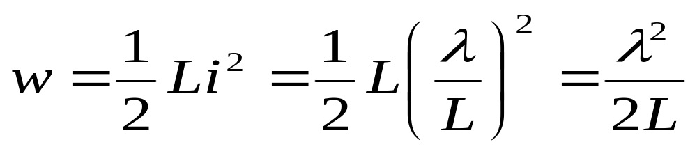
Example (Johnson&Johnson)
Derive an expression for the energy stored in an inductor in terms of the flux linkage λ and the inductance L.

Slide 37
Example (Johnson&Johnson)
A 2mH inductor has a voltage v=2cos(1000t) V with i(0)=1.5 A.
Find the energy stored in the inductor at t=π/6 ms.

Slide 38


Example (Johnson&Johnson)
A 2mH inductor has a voltage v=2cos(1000t) V with i(0)=1.5 A.
Find the energy stored in the inductor at t=π/6 ms.
(substitution method of integration)

Slide 39


Series and Parallel Inductors
The equivalent of a chain of series-connected
inductors is a single inductor whose inductance is the sum of the individual inductances.

Slide 40


Series and Parallel Inductors
The equivalent of a chain of series-connected
inductors is a single inductor whose inductance is the sum of the individual inductances.
The equivalent of parallel inductors is a single inductor
whose inverse inductance is the sum of inverses of the
parallel inductances:

Slide 41

Example
Find the equivalent inductance for the following circuit. Then find v.

Slide 42


Example
Find the equivalent inductance for the following circuit. Then find v.

Slide 43

Example : Inductor Voltage/Current Division
Derive the equation for voltage division:

Slide 44

Example : Inductor Voltage/Current Division
Derive the equation for voltage division:

Slide 45

Example : Inductor Voltage/Current Division
Derive the equation for voltage division:
Derive the equation for current division, given no initial current:

Slide 46

Example : Inductor Voltage/Current Division
Derive the equation for voltage division:
Derive the equation for current division, given no initial current:

Slide 47
DC Steady State
• A circuit is in dc steady state if currents and voltages are all
constant in the circuit.
• Circuits with inductors and capacitors in dc steady state can
be analyzed using previous techniques by replacing inductors
with short circuits and capacitors with open circuits.

Slide 48

Example
Assume the below circuit is in dc steady state. Find i and v.

Slide 49



Example
Assume the below circuit is in dc steady state. Find i and v.
DC steady-state equivalent:
KVL (Outer Loop):
KVL (Left Inner Loop):

Slide 50


Example
Assume the switch in the below circuit has been closed “for a long time”.
It was opened at time 0. Times 0- and 0+ refer to the instants before and after opening the switch respectively.
- Find a value for the source function so that i(0+)=2 A.
- For this , find v(0-) and v(0+).

Slide 51
Example
Assume the switch in the below circuit has been closed “for a long time”.
It was opened at time 0. Times 0- and 0+ refer to the instants before and after opening the switch respectively.
- Find a value for the source function so that i(0+)=2 A.
- For this , find v(0-) and v(0+).
Answer:
First note that current through an inductor and
voltage across a capacitor CANNOT change
instantaneously i.e. current through an inductor
and voltage across a capacitor have to be
continuous.
i(0+) = i(0-) and v(0+) = v(0-)
In addition, assume the circuit has been in dc steady state (capacitor open circuit, inductor short circuit) before the switch is opened at t=0 :
Using KVL at t=0- :

Slide 52


Practical Capacitors and Inductors
• A practical (real) capacitor has leakage through the dielectric, which can be modeled using a parallel resistance.
• A practical inductor has significant resistance due to the fact that the wire in the coil that makes up the inductor is significantly long. In addition there are core losses due to currents induced in the core by the magnetic field. The overall loss can be modeled by adding a series resistance.

